Slide 1


TEAM UMAAAS PRESENTS...
THE STUDY ABROAD EXPERIENCE REVIEW SYSTEM
March 10, 2023
Team UMAAAS

Slide 2

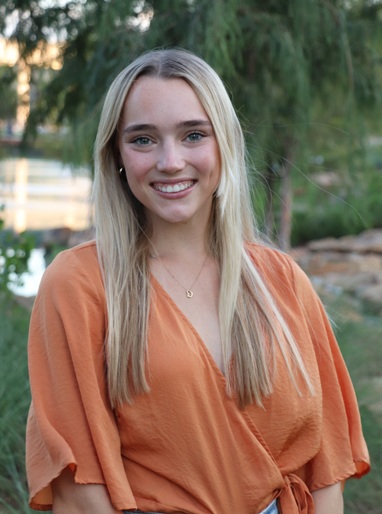
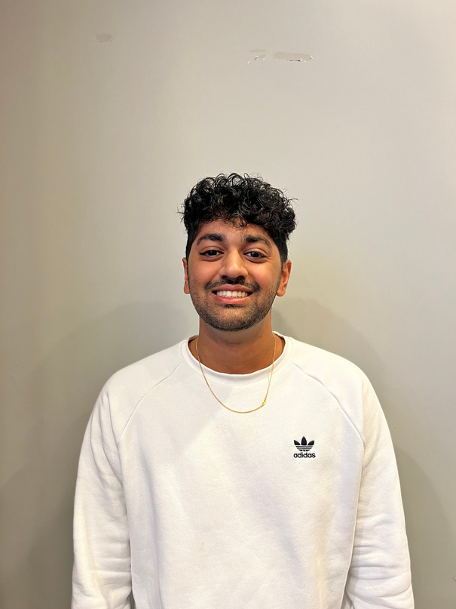
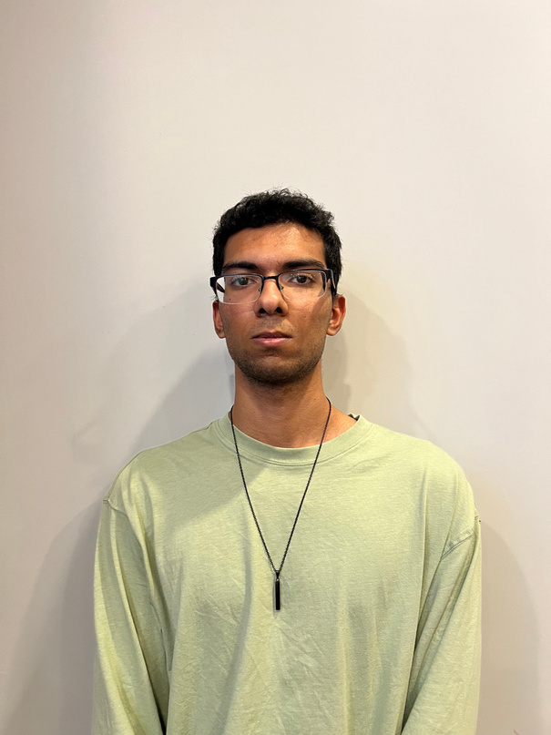
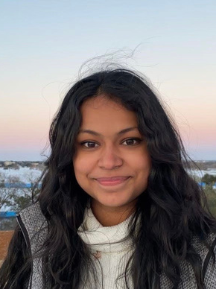
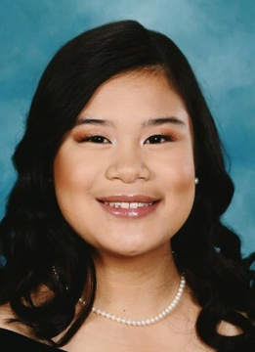
MEET THE TEAM
ARKA BOSE
MOLLY FROST
ANUJ KETKAR
ABHISHEK MORE
UMA SARKAR
SARAH SOTELO
Team UMAAAS

Slide 3
The Main Idea:
A convenient reviews website for Aggie study abroad trips
Add/rate experiences in your program
Create comments
Add/rate helpful tips
Audience: For current and prospective study abroad students
Why? A practical way for students to share ideas about opportunities in different countries
Team UMAAAS
Notes:
mol

Slide 4

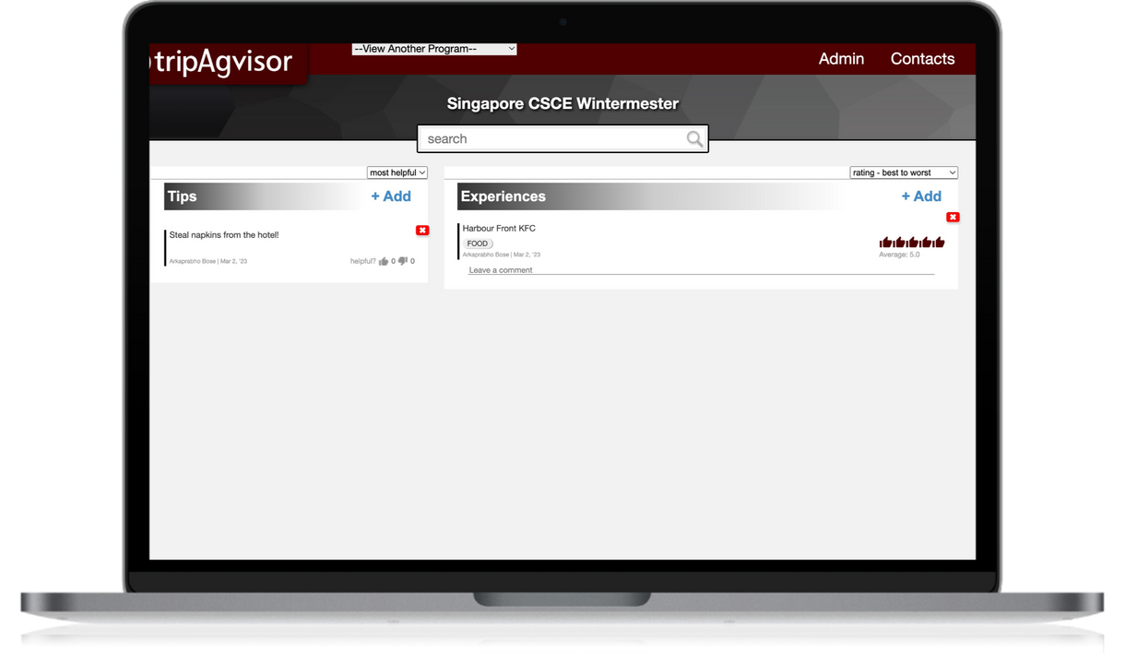
Our Design..
VS.
Team UMAAAS

Slide 5
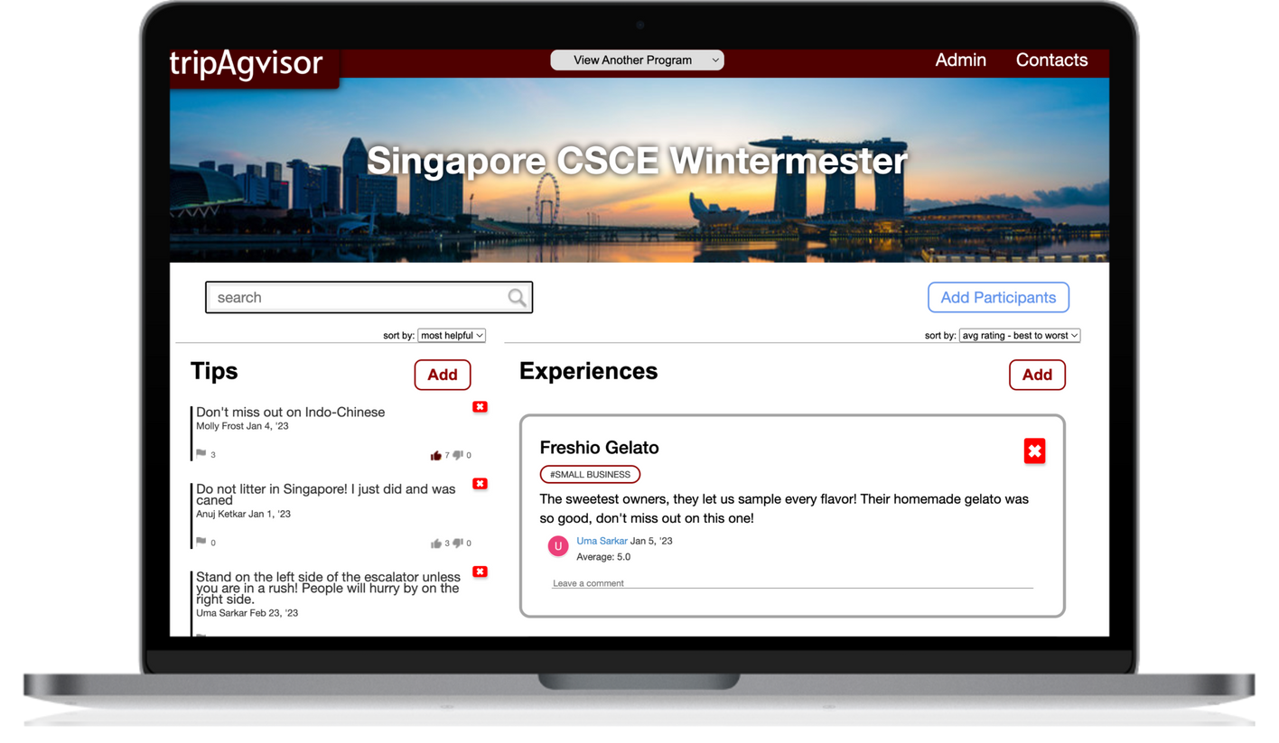

Our Design..
VS.
Team UMAAAS

Slide 6
Maroon
Navigation Bar
Our Design
Specific Program Picture
Each program has a specific picture
Navigation Bar with simply actions for the users
Aggie Maroon Incorporated(of course)
Tips and Experience divides the page
Split Screen for Tips and Experience
Team UMAAAS

Slide 7
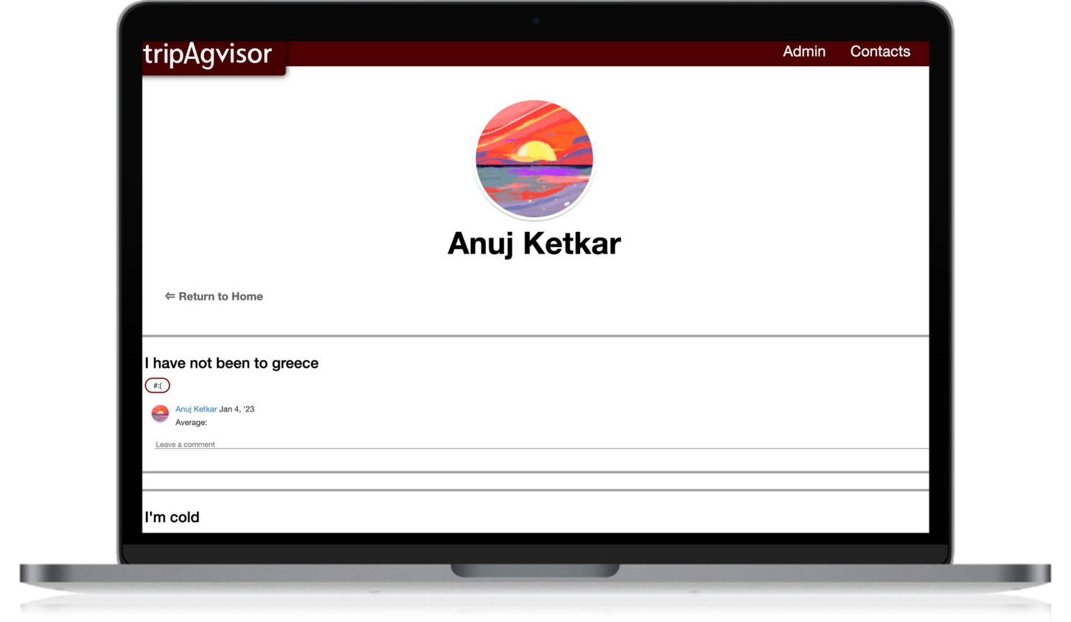
Maroon
Navigation Bar
Our Design
Profile Picture
Profiles have the google picture of the user
Navigation Bar is consistent
List of Experiences created by the profile of the user
List of all experience from the user
Team UMAAAS

Slide 8
What Has Been Completed?
Profile page
Flags for tips and experience
Admin portal
UI Upgrades
Adding photos to experiences
Adding Participants, Admin, and Programs
Specific main picture for each program
Team UMAAAS
Notes:
um

Slide 9
Challenges:
Flags...mistakes on adding flags to the database
Figuring out testing
Refactoring the database constantly to add new features
Storing images in the cloud for experience images
Setting up the environment
Creating documentation
Understand the legacy and cleaning it up
Team UMAAAS
Notes:
an

Slide 10
Lessons Learned...
through quotes
Team UMAAAS
Notes:
ab and ark

Slide 11
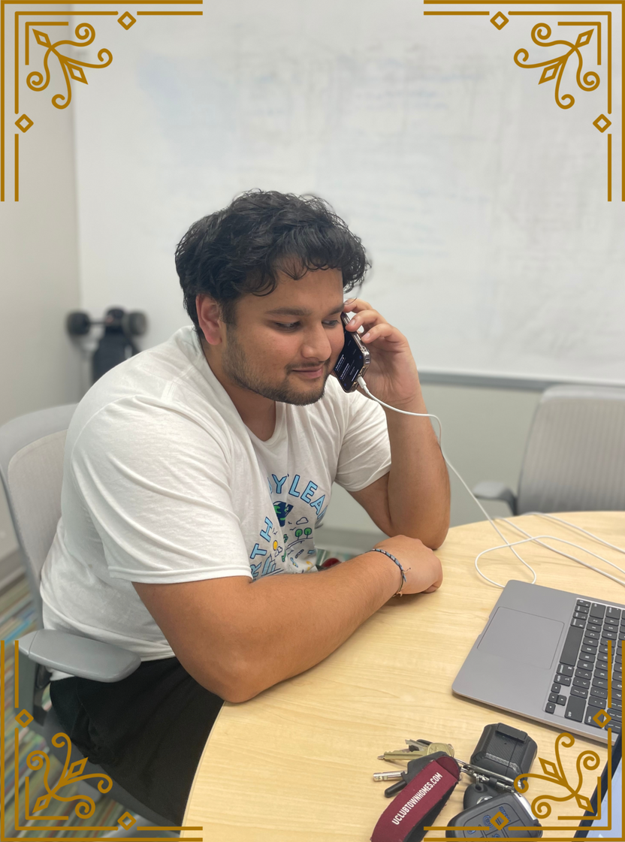
Lessons Learned:
"Communication is key"
-Arka
Team UMAAAS
Notes:
an

Slide 12
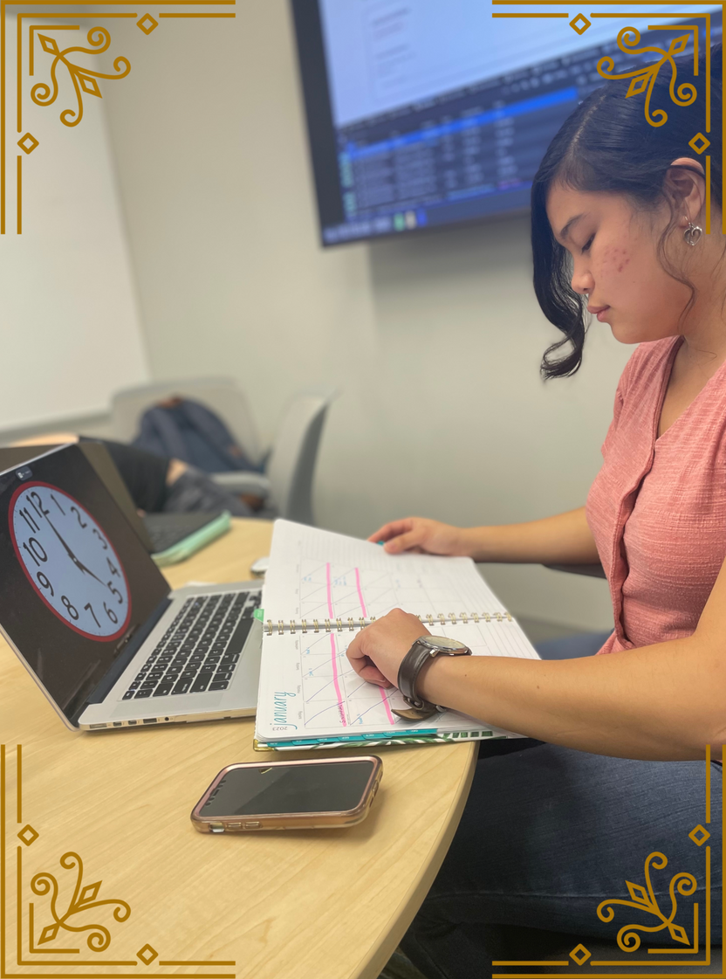
Lessons Learned:
"Time management is your best-friend"
-Sarah
Team UMAAAS
Notes:
an

Slide 13
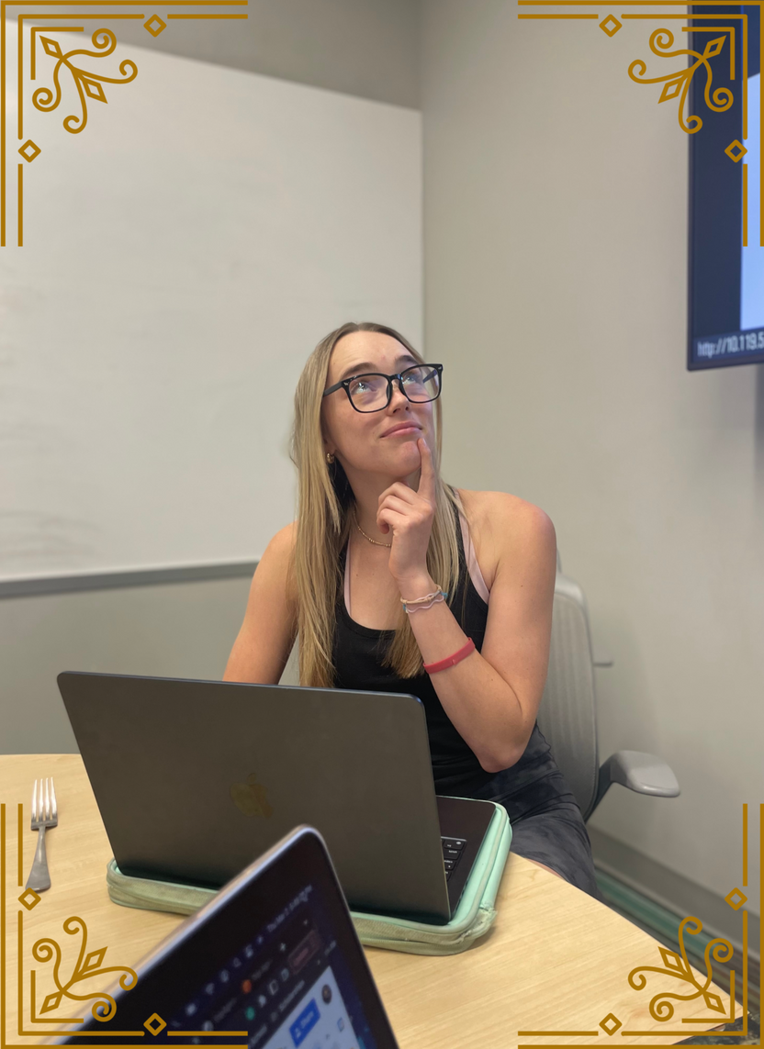
Lessons Learned:
"Research can go a long way"
-Molly
Team UMAAAS
Notes:
an

Slide 14
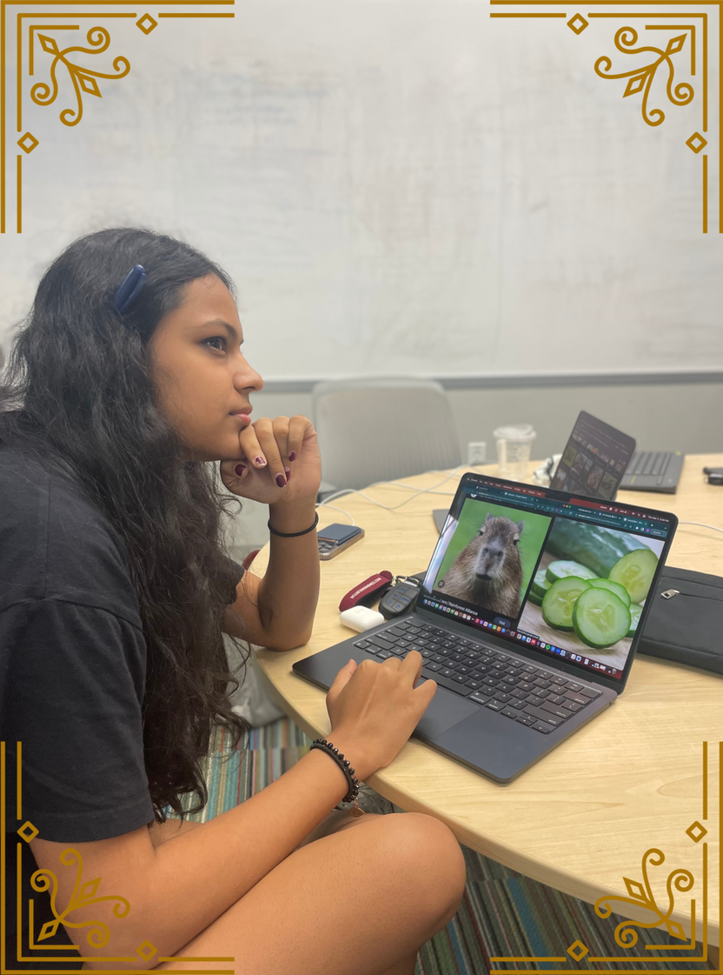
Lessons Learned:
"Test driven development is THE way to go"
-Uma
Team UMAAAS
Notes:
an

Slide 15
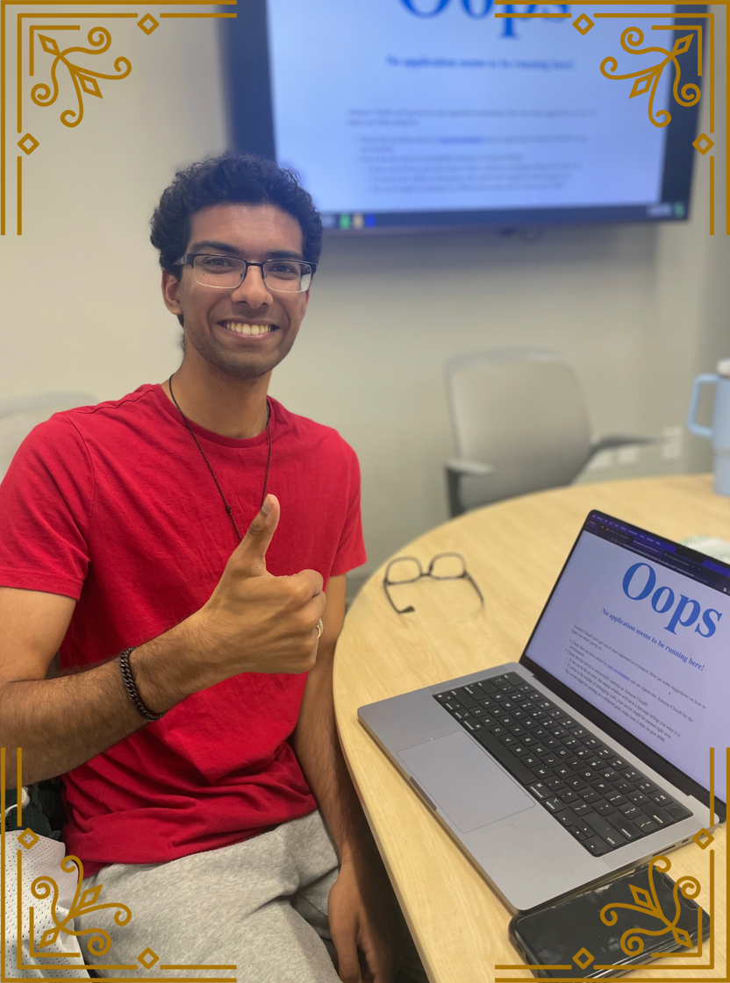
Lessons Learned:
"Don't let set backs set you back"
- Abhishek
Team UMAAAS
Notes:
an

Slide 16
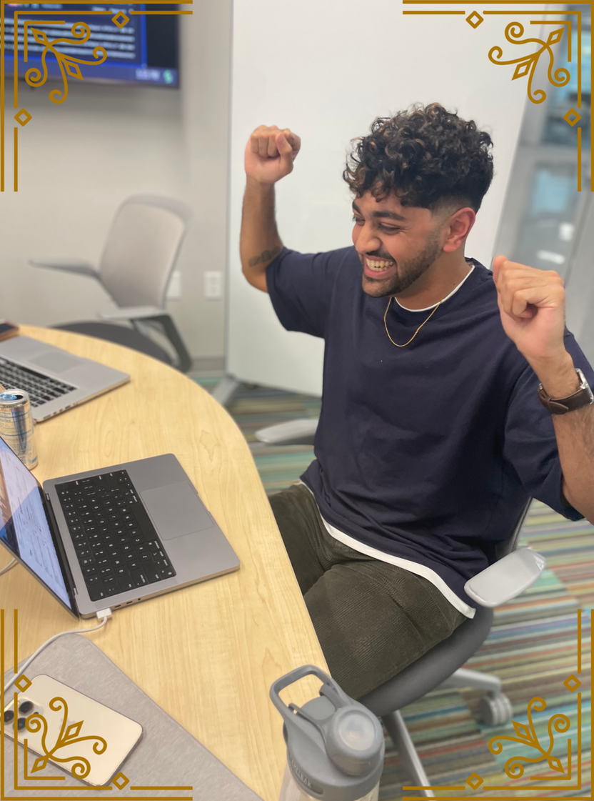
Lessons Learned:
"Always remember to have fun"
-Anuj
Team UMAAAS
Notes:
an

Slide 17
Thank you for watching!
Team UMAAAS

Slide 18

It's Demo Time!
https://tripagvisor.herokuapp.com/
Team UMAAAS
Notes:
ab and ark

Slide 19
Any Questions?
Team UMAAAS

